Slide 1
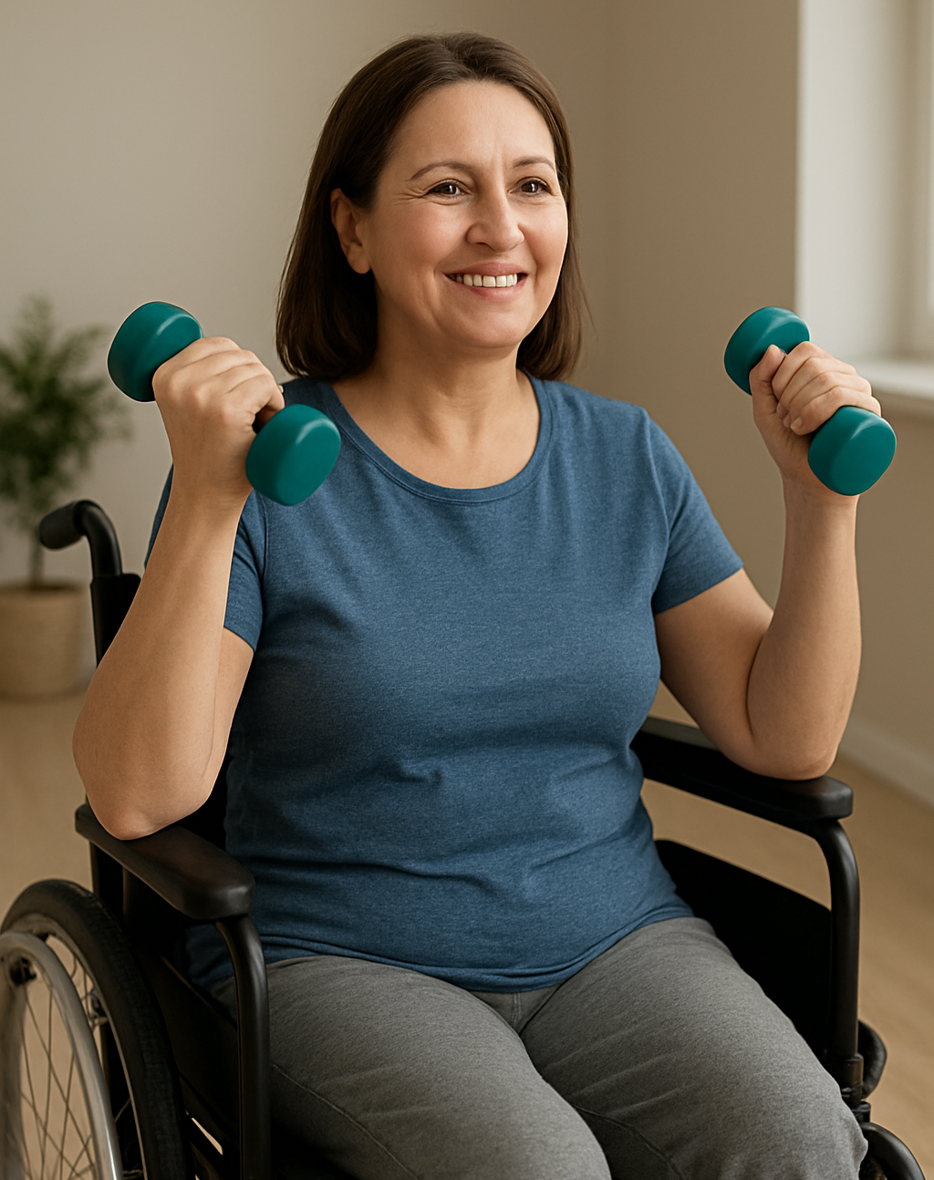
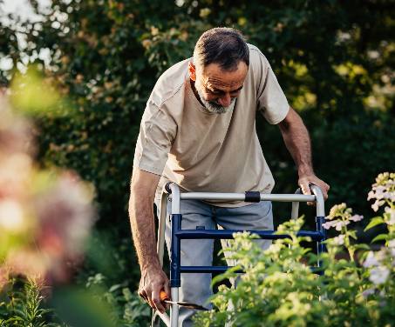
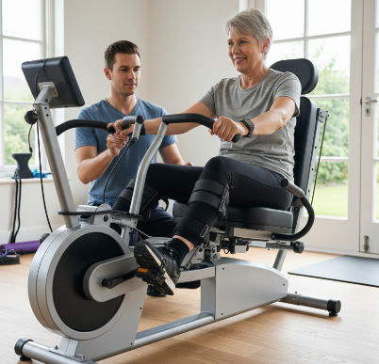
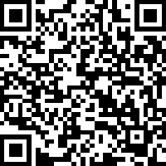
Perspectives on physical activity and exercise among people with lived experience of advanced multiple sclerosis
We are conducting research to explore experiences with physical activity and exercise among people with advanced multiple sclerosis.
We want to know more about the factors that influence your ability to participate and whether your physical activity and exercise have changed over time.
You may be eligible to participate in this study if you:
Are an adult with advanced multiple sclerosis, who uses assistive devices, such as a cane, walker or a wheelchair for moving around
Live in Australia
AI generated images
Taking part in this study will involve you completing an anonymous 30-minute online survey about your background, current levels of physical activity and exercise, and any factors that influence this.
At the end of the survey, we will ask whether you are interested in participating in an interview lasting a maximum of 60 minutes to discuss your experiences in more detail.
You can use the QR code to access the survey.
Please contact Dr Suzie Máté for more information.
suzanne.mate@sydney.edu.au or 02 9351 9566.
This study has been approved by The University of Sydney Human Research Ethics Committee (HREC) 2025/HE001730. Version 2 26/03/2026

